Slide 1

An mHealth (Mobile Health) Intervention for Smoking Cessation
in People With Tuberculosis
A Cluster Randomized Clinical Trial

Slide 2

Dr. Maham Zahid Post-doc Research Fellow
https://orcid.org/0000-0003-2878-0435
https://www.linkedin.com/in/maham-zahid-330766227/
Pharm-D (Riphah International University, Islamabad)
Clinical Research Certified Professional (Harvard University, USA)
Masters in Science of Public Health (Health Services Academy, Islamabad)
PhD Public Health (Khyber Medical University, Peshawar)
Clinical research and clinical trials expert – 10 years experience
Expertise: Epidemiology, RCTs, infectious diseases, data management and statistical analysis
Field experience: Community based cluster randomized controlled trial in Punjab and Sindh, Karachi
Technical roles: Clinical Research Associate, Trial manager, Trial pharmacist, Research officer
Collaboration: University of Edinburgh UK, University of York UK, Catholic University of Health and Allied Sciences Tanzania,
Research grant recipient as CoPI (WHO grant on leishmaniasis, mental health in COVID-19
Web of science collection metrics
12
52
Peer-Reviewed
International Journal Publications
Total
Citations
04
05
h-index
International Conference
Presentations

Slide 3

Disclosure statements
This study was funded by NIHR 16/136/109 and NIHR132826 using UK international development funding from the UK Government to support global health research. The views expressed in this publication are those of the author(s) and not necessarily those of the NIHR or the UK Government.
I have not received any tobacco-related research funding over the previous 10 years. I have no other conflict of interest to disclose.

Slide 4


Quit4TB project
Project title: A mHealth intervention for smoking cessation in people with tuberculosis: a two-stage adaptive design, randomised trial
Project design: Comprised of four phases
Countries: Bangladesh & Pakistan
Project PIs: Kamran Siddiqi (University of York, UK), Amina Khan (The Initiative, Pakistan), Rumana Huque (The ARK foundation, Bangladesh)
Project sponsor: University of Edinburgh, UK
Project funding: RESPIRE NIHR UK
Project timeline: Jun 2022 – Jun 2026

Slide 5
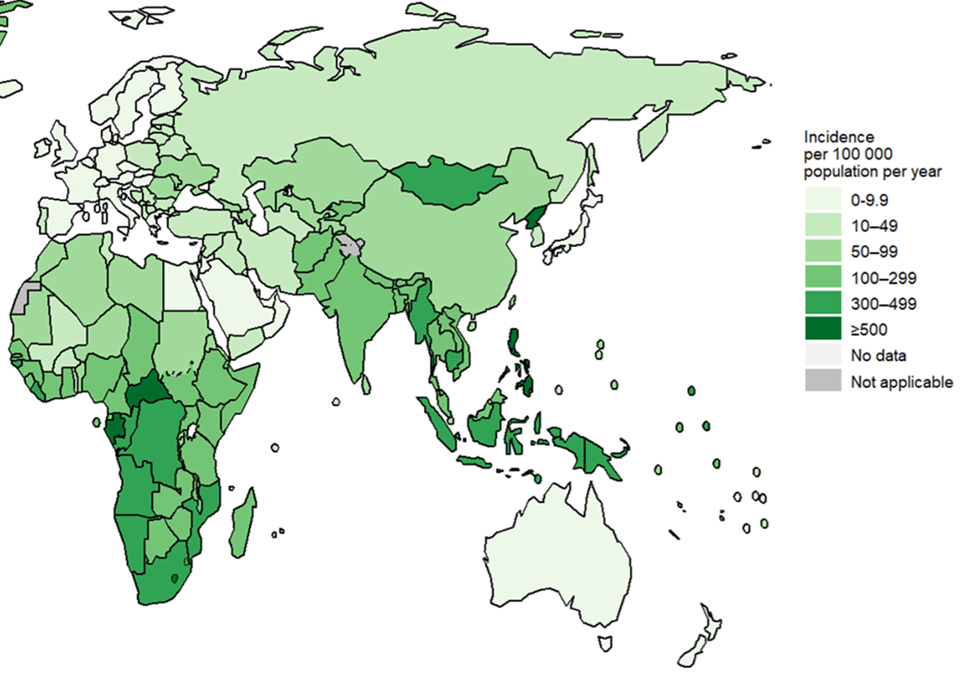
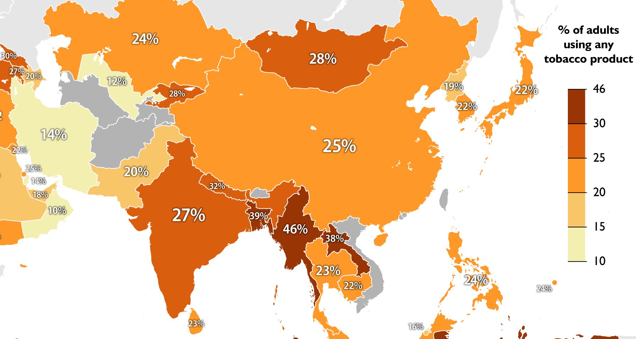
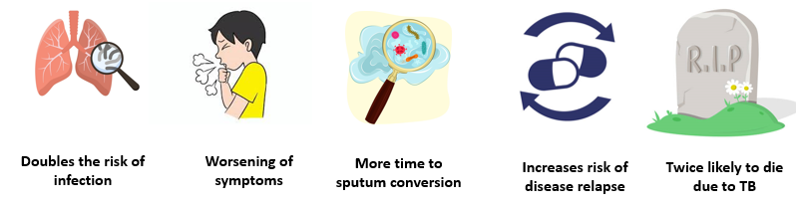
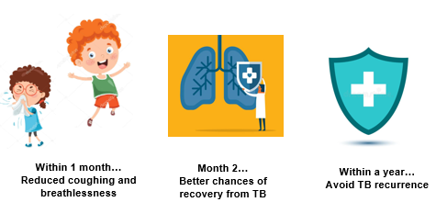
Introduction
Globally, 10.7 million new tuberculosis cases and 1.2 million related deaths were reported in 2024 (He H et al, 2022)
Pakistan ranks 5th while Bangladesh ranks 6th among highest-TB burden countries (Zhang T et al, 2023)
Globally, >1.3 billion people use tobacco,(WHO, 2021) and high tobacco use reported in Bangladesh and Pakistan
Adverse relationship between TB & Tobacco use (Burusie A et al, 2020)
Benefits of quitting smoking in TB patients (Siddiq K et al, 2022)
Notes:
He H, Pan Z,Wu J, Hu C, Bai L, Lyu J. Health effects of tobacco at the global, regional, and national levels: results from the 2019 Global Burden of Disease study. Nicotine Tob Res. 2022;24(6):864-870.
Zhang T, Zhang J, Wei L, Liang H, Zhang J, Shi D, Wang Z. The global, regional, and national burden of tuberculosis in 204 countries and territories, 1990–2019. Journal of infection and public health. 2023 Mar 1;16(3):368-75. World Health Organization. WHO global report on trends in prevalence of tobacco use 2000–2025.
Burusie A, Enquesilassie F, Addissie A, Dessalegn B, Lamaro T. Effect of smoking on tuberculosis treatment outcomes: A systematic review and meta-analysis. PloS one. 2020 Sep 17;15(9):e0239333. Siddiqi K, Keding A, Marshall AM, Dogar O, Li J, Huque R, Fatima R, Khan A, Elsey H, Gabe R, Kotz D. Effect of quitting smoking on health outcomes during treatment for tuberculosis: secondary analysis of the TB & Tobacco Trial. Thorax. 2022 Jan;77(1):74-8.

Slide 6




Importance
17–32% prevalence of smoking among patients with TB (Marshall AM et al, 2020)
Those who quit, show better clinical outcomes (Siddiqi K, 2022)
A number of evidence-based smoking cessation interventions reported in literature (Lu CL et al, 2024)
Cessation is poorly addressed in lower and middle income countries like Bangladesh & Pakistan due to various barriers (Zvolska K et al, 2020)
To overcome the challenges, need to explore cost-effective and scalable interventions (e.g. mHealth based interventions)
Notes:
Marshall AM, Barua D, Mitchell A, et al. Smoking prevalence among tuberculosis patients: a cross sectional study in Bangladesh and Pakistan. Tob Induc Dis. 2020;18:70.
Lu CL, Li JX, Wang QY, Wang RT, Pan XR, Chen XY, Wang CJ, Chen RL, Yang SH, Zhao ZH, Jiang JJ. Interventions for smoking cessation: An overview of Cochrane reviews. Tobacco induced diseases. 2024 Nov 28;22:10-8332.
Zvolska K, Pankova A, Nohavova I, Huque R, Elsey H, Boeckmann M, Sheikh A, Siddiqi K, Kralikova E. A narrative review of facilitators and barriers to smoking cessation and tobacco-dependence treatment in patients with tuberculosis in low-and middle-income countries. Tobacco induced diseases. 2020 Aug 6;18:67.

Slide 7



What’s already proven to works in general population…
Medicines:
Varenicline (OR=2.31), bupropion (OR=1.43), cytisine (OR = 2.21), nicotine patch (OR=1.3) Cochrane Review, 2023; https://doi.org/10.1002/14651858.CD015226.pub2
Behavior support (BS):
Counselling vs minimal support (RR=1.44)
Compared with in addition to pharmacotherapy (RR=1.24)
Cochrane review 2021; https://doi.org/10.1002/14651858.CD013229.pub2
mHealth based interventions
SMS vs minimal support (OR=1.54)
SMS+cessation support vs cessation support (OR=1.59)
Cochrane review 2019; https://doi.org/10.1002/14651858.CD006611.pub5
Notes:
Cochrane Review, 2023; https://doi.org/10.1002/14651858.CD015226.pub2
Cochrane review 2021; https://doi.org/10.1002/14651858.CD013229.pub2
Cochrane review 2019; https://doi.org/10.1002/14651858.CD006611.pub5

Slide 8
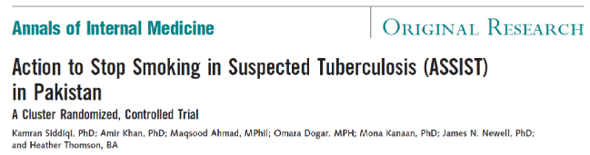
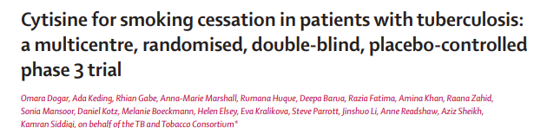
Previous research on smoking cessation in patients with TB….
Three arms: behavioral support sessions (BSS), BSS plus 7 weeks of bupropion therapy (BSS+), or usual care.
41.0% vs 8.5%, 45.4% vs 8.5; RR=7.4, RR=8.2
Two arms: behavioral support sessions (BSS) plus 4 weeks of oral cytisine therapy, or BSS plus placebo.
32.4% vs 29.7% quit rate, RR=1.09
Notes:
Siddiqi K, Khan A, Ahmad M, Dogar O, Kanaan M, Newell JN, Thomson H. Action to stop smoking in suspected tuberculosis (ASSIST) in Pakistan: a cluster randomized, controlled trial. Annals of internal medicine. 2013 May 7;158(9):667-75.
Dogar O, Keding A, Gabe R, Marshall AM, Huque R, Barua D, Fatima R, Khan A, Zahid R, Mansoor S, Kotz D. Cytisine for smoking cessation in patients with tuberculosis: a multicentre, randomised, double-blind, placebo-controlled phase 3 trial. The Lancet Global Health. 2020 Nov 1;8(11):e1408-17.

Slide 9
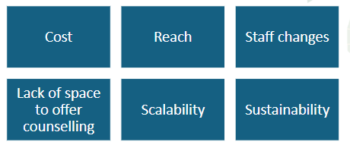
Implementation barriers of Face-to-Face behaviour support in routine TB care
Boeckmann M, Warsi S, Noor M, Dogar O, Mustagfira EH, Firoze F, Zahid R, Readshaw A, Siddiqi K, Kotz D. Health worker and patient views on implementation of smoking cessation in routine tuberculosis care. NPJ primary care respiratory medicine. 2019 Sep 3;29(1):34.

Slide 10
Evidence gap
To evaluate more cost-effective and scalable interventions to help patients with TB quit smoking

Slide 11
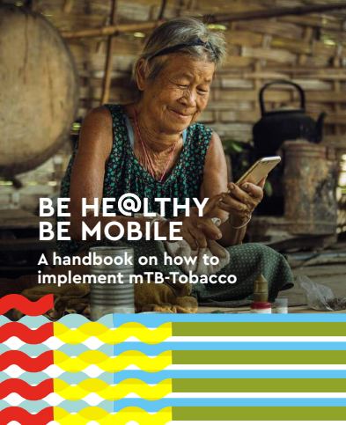

WHO developed a mHealth smoking cessation package (mTB-Tobacco) that can be delivered as SMS messages via mobile phones in TB patients
informative content on TB disease awareness, Rx adherence, healthcare visit reminders, consequences of tobacco use and motivational content on tobacco cessation (WHO, 2019)
Notes:
World Health Organization. A Handbook on How to Implement mTB-Tobacco. Published 2019. https://apps.who.int/iris/bitstream/handle/10665/325243/9789241515900-eng.pdf

Slide 12
Quit4TB Project Design (Zahid M et al, 2025)
PHASE 1
PHASE 2
Involving community into the study processes to get feedback on study materials and SMS log
(PPI)
01
Pilot at 2 TB sites to test feasibility and acceptability of intervention
(Pilot trial)
04
02
PHASE 4
PHASE 3
Comparison of mTB Tobacco intervention with behavior support
(Non-inferiority trial)
Comparison of mTB Tobacco intervention with usual care
(Superiority trial)
03
Notes:
Zahid M, Rahman F, Chowdhury A, Rana SH, Ansaari S, Lim AK, Danaee M, Boeckmann M, Parrott S, Norrie J, Khan A. mHealth intervention (mTB-Tobacco) for smoking cessation in people with drug-sensitive pulmonary tuberculosis in Bangladesh and Pakistan: protocol for an adaptive design, cluster randomised controlled trial (Quit4TB). BMJ open. 2025 Feb;15(2):e089007.

Slide 13
Superiority trial mTB-Tobacco vs Usual care
Primary objective:
To assess the effectiveness of mHealth intervention in achieving smoking abstinence at 6 months among patients with TB who smoke compared to usual care
Secondary objectives:
To assess point abstinence at 2-months
To assess TB treatment adherence
To assess TB treatment outcomes

Slide 14
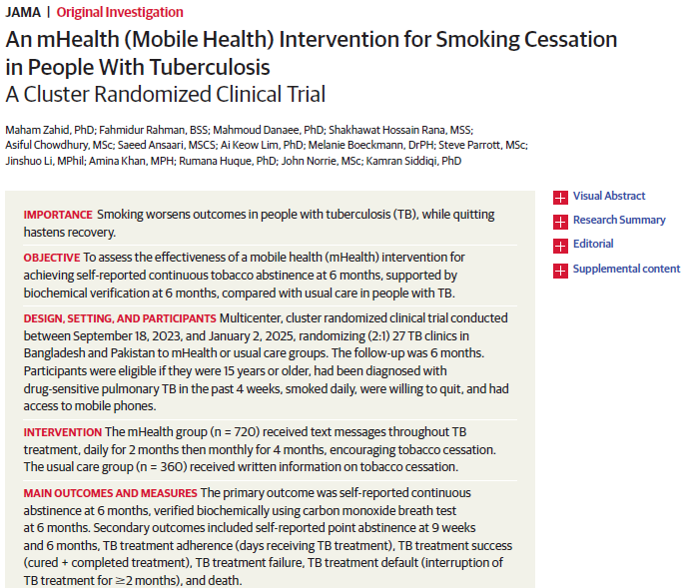
Superiority trial (phase 3)

Slide 15
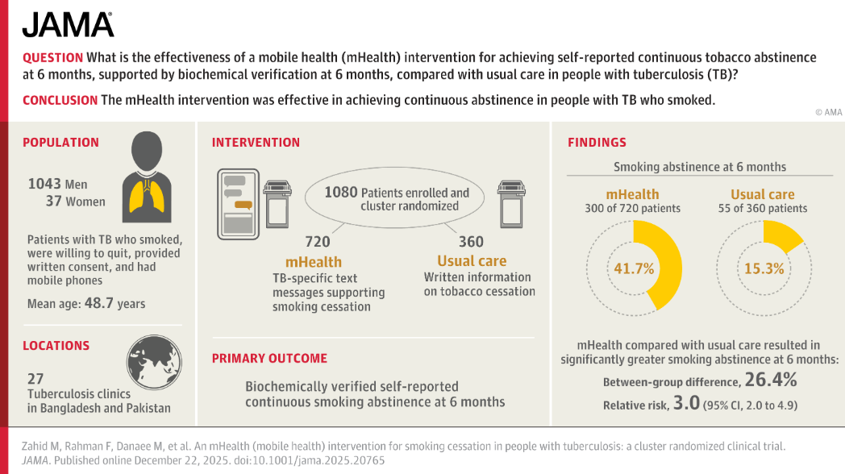
Notes:
Zahid M, Rahman F, Danaee M, Rana SH, Chowdhury A, Ansaari S, Lim AK, Boeckmann M, Parrott S, Li J, Khan A. An mHealth (mobile health) intervention for smoking cessation in people with tuberculosis: a cluster randomized clinical trial. JAMA. 2026 Jan 27;335(4):336-44.

Slide 16

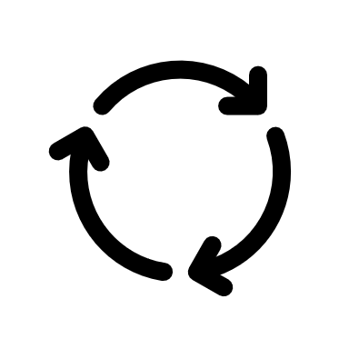


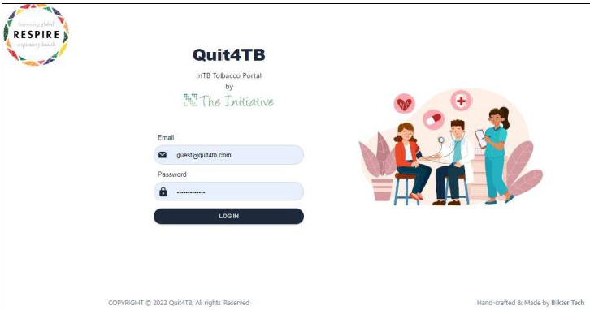
mHealth Intervention
134 text messages, translated in Urdu and Bangali, delivered as SMS messages to participant’s mobile phones during TB treatment period delivered
mTB Tobacco portal (www.quit4tb.com, https://mhealth.theinitiative.org.pk) was established, it was used to send autogenerated SMS messages to participants belonging to intervention clusters only

Slide 17


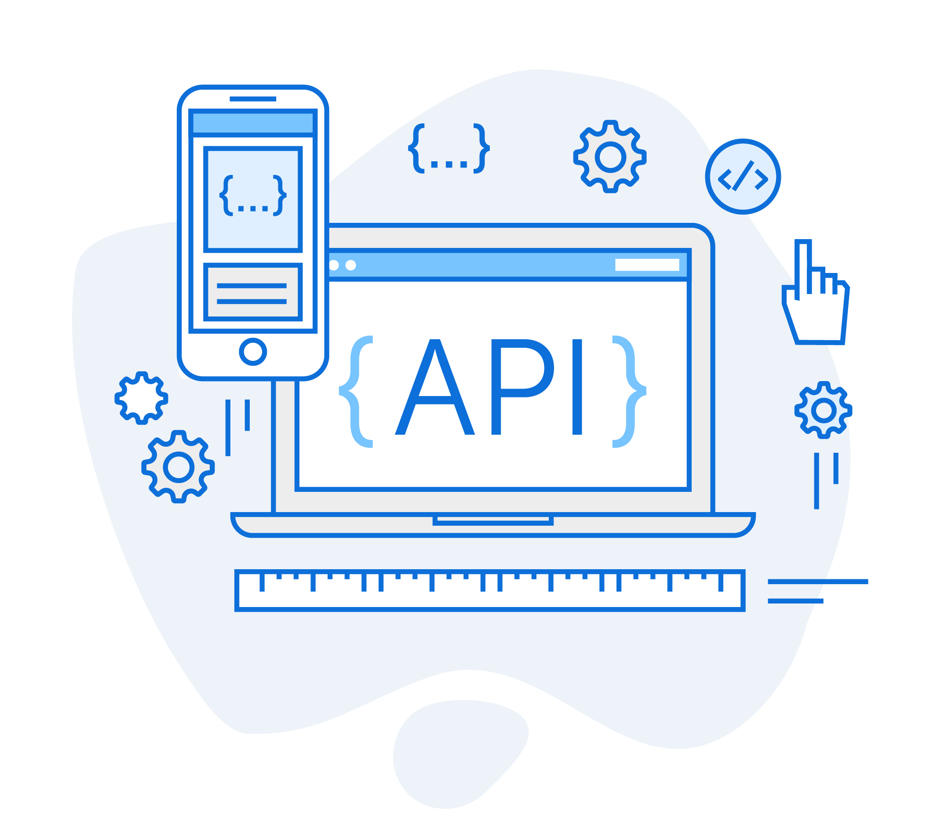

REDCap Server
Integration of mHealth and REDCap screening eCRF
Research Assistant screened/enrolled participant
1
Web-based mTB-Tobacco portal
mTB-Tobacco portal fetched enrolled participant’s phone numbers directly from RedCap server
2
Participant information stored on mTB-Tobacco portal
3
Portal sent autogenerated SMS to intervention cluster participants through local SMS service providers.
4
Portal maintained sent SMS log, and flagged issues/errors
5

Slide 18

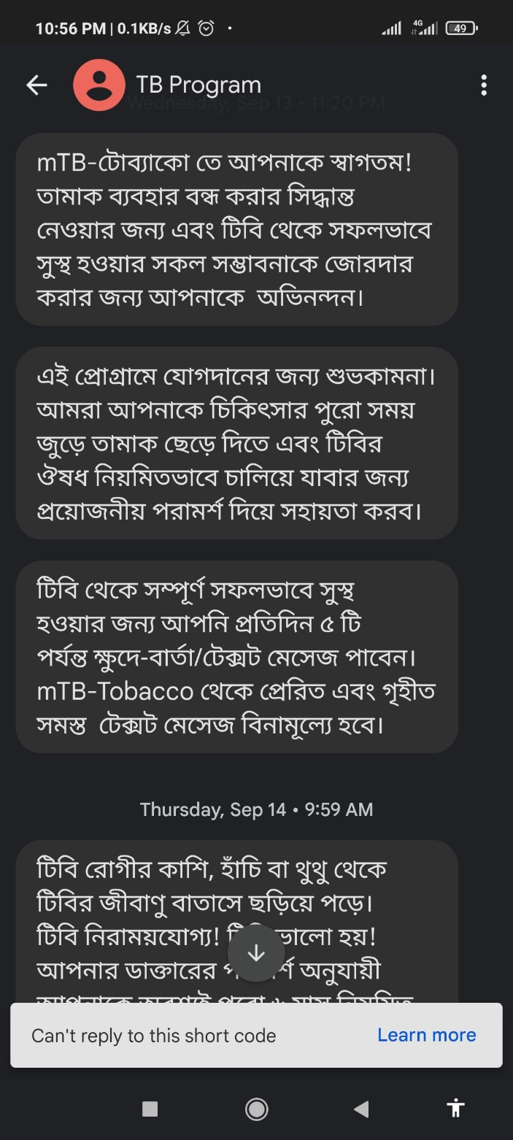



Masking of SMS
TB Program
Participants received SMS messages by name of
TB program
“Easy to remember, Easy to recognize”
Masking was Registered in Both Countries
Message 1 Sent
Message 2
Scheduled
Message 3 Scheduled
Message 4 Scheduled
Message 5 Scheduled

Slide 19
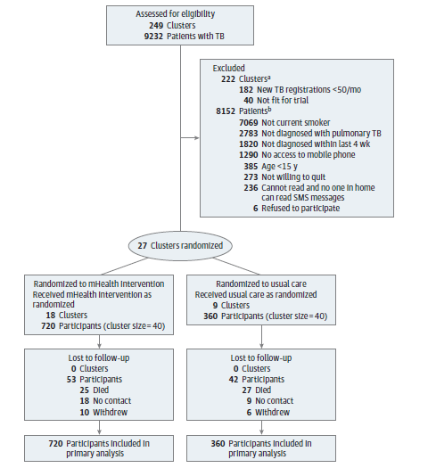
Consort Flow

Slide 20
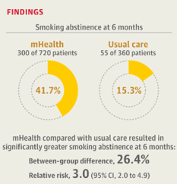
Results Primary outcomes
ITT analysis
(biochemical verification cut-off <10ppm CO

Slide 21
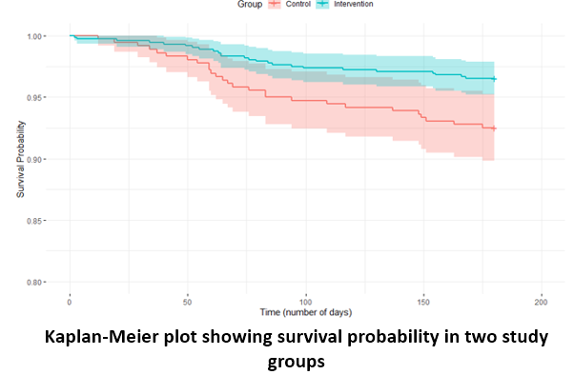
Results Secondary outcomes

Slide 22
Conclusion
Among people with TB who smoke tobacco, an mHealth intervention was effective in promoting continuous abstinence. mHealth is a feasible, effective, and potentially scalable means of supporting tobacco cessation.

Slide 23
Recommendations / way forward
Integrate tobacco use screening into routine TB care
Make tobacco cessation support a standard component of TB
Adopt the mHealth intervention nationally as a cost-effective and scalable approach
Embed tobacco cessation within the National TB Strategic Plan
Allocate sustainable resources and strengthen partnerships

